Slide 1

This course was developed as a part of the VLIR-UOS Cross-Cutting project s:
Statistics: 2011-2016, 2017.
Statistics: 2017.
Statistics for development : 2018-2022.

Slide 2





Basic concepts in statistical modeling using R: The One-way ANOVA model
The >eR-Biostat initative
Making R based education materials in statistics accessible for all
Developed by
Legesse Kassa Debusho (UNISA), Ziv Shkedy (Hasselt University)
https://erbiostat.wixsite.com/erbiostat
ER-BioStat
https://github.com/eR-Biostat
Email: erbiostat@gmail.com
@erbiostat

Slide 3
contents
The One-way ANOVA model:
  Model formulation.
  Sources of Variability.
  One-way ANOVA using R: the aov() function.
  Hypotheses testing.
  Analysis of the pharmaceutical experiment.
  Model diagnostic in R:
    Residual plot.
    normal probability plot.
  Multiple testing.

Slide 4

Recommended reading
In this part of the course, we cover mainly Section 5.5 in the book.
The examples that are used for illustration are not the same as the examples in the book.
The book is available for free online:
https://www.openintro.org/book/biostat/
Section 5.5: Comparing means with ANOVA

Slide 5
Graphical displays
Graphical displays in the course were produced using the old R functions for graphical displays.
Better figures can be produced using te ggplot2 package.

Slide 6
Introduction:
The one-way ANOVA model

Slide 7
Example: a Biopharmaceutical problem
The data
A group of 24 rats were randomized into two treatment groups: active drug and placebo
After the administration of the drug, the rat was placed on a surface, and the distanced traveled by the rat (in meters) was measured.
> print(Biophar)
Obs Treat Dist
22 QNP 186.6145
11 QNP 103.3529
4 QNP 191.3850
16 QNP 334.9845
7 QNP 89.2831
13 QNP 345.5070
2 QNP 169.5161
20 QNP 173.1491
19 QNP 130.9634
8 QNP 363.4392
10 QNP 76.5340
24 QNP 202.1145
1 SALINE 12.8458
17 SALINE 44.3092
15 SALINE 41.3581
6 SALINE 24.5560
23 SALINE 61.5525
18 SALINE 38.8464
5 SALINE 27.0107
12 SALINE 45.9960
21 SALINE 13.7927
14 SALINE 42.4009
3 SALINE 17.5861
9 SALINE 11.7937
Response
Treatment group

Slide 8
The evaluation of the rat
Y_{i} is the distance traveled by the rat during the experiment.
rat

Slide 9
Description of the experiment
Passive rat
Active rat
It is assumed that a successful drug increase the distance traveled by the rat during the experimant.

Slide 10
The scientific question
Does the drug increase the distance traveled by the rat ?
A good drug is expected to improve the rats’ performance, i.e. to increase the distance travel by the rat

Slide 11
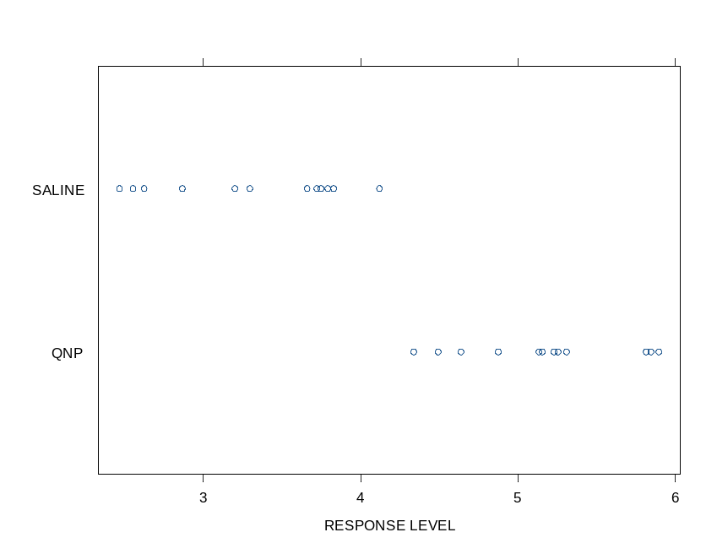
Graphical display of the data (1)
The data
22 QNP 186.6145
11 QNP 103.3529
4 QNP 191.3850
16 QNP 334.9845
7 QNP 89.2831
13 QNP 345.5070
2 QNP 169.5161
20 QNP 173.1491
19 QNP 130.9634
8 QNP 363.4392
10 QNP 76.5340
24 QNP 202.1145
1 SALINE 12.8458
17 SALINE 44.3092
15 SALINE 41.3581
6 SALINE 24.5560
23 SALINE 61.5525
18 SALINE 38.8464
5 SALINE 27.0107
12 SALINE 45.9960
21 SALINE 13.7927
14 SALINE 42.4009
3 SALINE 17.5861
9 SALINE 11.7937
A strip plot
Response
Treatment
groups
The response level (on log scale)
Treatment group

Slide 12
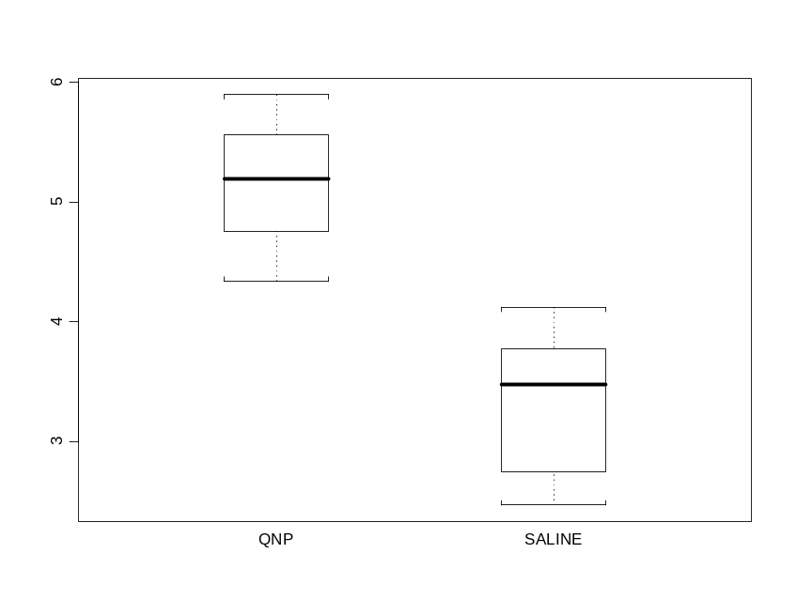
Graphical display of the data (2)
The data
22 QNP 186.6145
11 QNP 103.3529
4 QNP 191.3850
16 QNP 334.9845
7 QNP 89.2831
13 QNP 345.5070
2 QNP 169.5161
20 QNP 173.1491
19 QNP 130.9634
8 QNP 363.4392
10 QNP 76.5340
24 QNP 202.1145
1 SALINE 12.8458
17 SALINE 44.3092
15 SALINE 41.3581
6 SALINE 24.5560
23 SALINE 61.5525
18 SALINE 38.8464
5 SALINE 27.0107
12 SALINE 45.9960
21 SALINE 13.7927
14 SALINE 42.4009
3 SALINE 17.5861
9 SALINE 11.7937
A boxplot plot
The response level (on log scale)
Response
Treatment
groups
Treatment group

Slide 13
Descriptive Statistics: overall mean
Min. 1st Qu. Median Mean 3rd Qu. Max.
2.468 3.569 4.229 4.244 5.173 5.896
The function summary( ) was used in order to calculate the overall mean.
The response is ldist (the distanc traveled on log scale)
> summary(Biophar$ldist)

Slide 14
Groups’ means
> tapply(ldist,Biophar$Treat,mean)
QNP SALINE
5.164716 3.323143
> tapply(ldist,Biophar$Treat,sd)
QNP SALINE
0.5179239 0.5719953
Using the function tapply ( ), the means and standard deviations are claculated for each level of the fractor (i.e., for each treatment group)
tapply(ldist, Biophar$Treat, mean)
tapply(ldist, Biophar$Treat, sd)

Slide 15
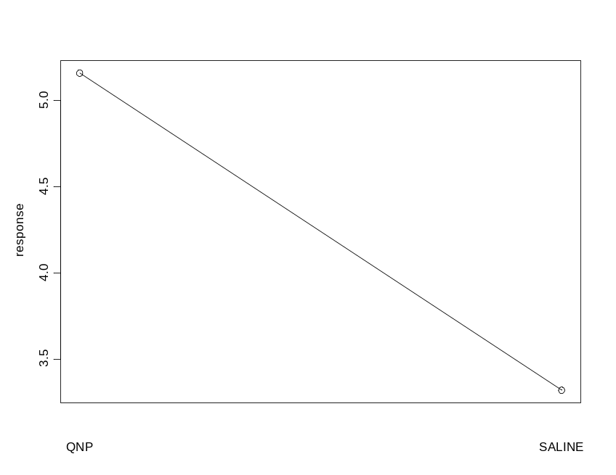
Graphical dispaly (3)
The mean plot, shows the mean at each factor level.
N
treat Obs N Mean Std Dev Minimum Maximum
-------------------------------------------------------------------------------------------------------
QNP 12 12 5.1647159 0.5179239 4.3377351 5.8956120
SALINE 12 12 3.3231425 0.5719953 2.4675655 4.1198905
----------------------------------------------------------------------------------------------------------

Slide 16

ANOVA terminology
The distance traveled in is the dependent variable. This is the response.
The treatment group is the independent variable and it is called the factor.
In this example the factor has two levels.
(X₁₁,Y₁₁)

Slide 17
Data structure
We have two variables, the factor (x) and the response (Y).
The value of X is equal for all subjects from the same treatment group.
This value is the factor level.
22 QNP 186.6145
11 QNP 103.3529
4 QNP 191.3850
16 QNP 334.9845
7 QNP 89.2831
13 QNP 345.5070
2 QNP 169.5161
20 QNP 173.1491
19 QNP 130.9634
8 QNP 363.4392
10 QNP 76.5340
24 QNP 202.1145
1 SALINE 12.8458
17 SALINE 44.3092
15 SALINE 41.3581
6 SALINE 24.5560
23 SALINE 61.5525
18 SALINE 38.8464
5 SALINE 27.0107
12 SALINE 45.9960
21 SALINE 13.7927
14 SALINE 42.4009
3 SALINE 17.5861
9 SALINE 11.7937
The factor: the treatment group
The response: the distance traveled ( y_{i} )

Slide 18
Data Structure: notation (1)
Y_{ij}
Group 1:
i=1
n₁=12
22 QNP 186.6145
11 QNP 103.3529
4 QNP 191.3850
16 QNP 334.9845
7 QNP 89.2831
13 QNP 345.5070
2 QNP 169.5161
20 QNP 173.1491
19 QNP 130.9634
8 QNP 363.4392
10 QNP 76.5340
24 QNP 202.1145
1 SALINE 12.8458
17 SALINE 44.3092
15 SALINE 41.3581
6 SALINE 24.5560
23 SALINE 61.5525
18 SALINE 38.8464
5 SALINE 27.0107
12 SALINE 45.9960
21 SALINE 13.7927
14 SALINE 42.4009
3 SALINE 17.5861
9 SALINE 11.7937
Group number: i=1,2
Observation number:
j=1,2,3,…,12
Group 2:
i=2
n₂=12
The sample size at the group.
Y2₂₁₂: Observation number 12 in group 2

Slide 19



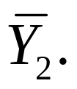
Data Structure: notation (2)
Group 1: The group mean
Number of Group: I
22 QNP 186.6145
11 QNP 103.3529
4 QNP 191.3850
16 QNP 334.9845
7 QNP 89.2831
13 QNP 345.5070
2 QNP 169.5161
20 QNP 173.1491
19 QNP 130.9634
8 QNP 363.4392
10 QNP 76.5340
24 QNP 202.1145
1 SALINE 12.8458
17 SALINE 44.3092
15 SALINE 41.3581
6 SALINE 24.5560
23 SALINE 61.5525
18 SALINE 38.8464
5 SALINE 27.0107
12 SALINE 45.9960
21 SALINE 13.7927
14 SALINE 42.4009
3 SALINE 17.5861
9 SALINE 11.7937
Sample size: n
n=n₁+n₂+,…,n_{k}
Overall mean:
Mean of group i:
Sample size in group i: n_{i}
Group 2: The group mean

Slide 20
Discriptive statistics
Min. 1st Qu. Median Mean 3rd Qu. Max.
2.468 3.569 4.229 4.244 5.173 5.896
Overall mean:
Mean of group i:
> tapply(ldist,Biophar$Treat,mean)
QNP SALINE
5.164716 3.323143

Slide 21
Sources of Variability

Slide 22
What is a One-Way ANOVA Model?
An One-Way ANOVA model is a statistical model which aims to explain the variability of the response variable.
The question of primary interest is IF THE MEAN RESPONSE IS DIFFERENT across the factor levels.
response
A
B
C
FACTOR

Slide 23
Two sources of variability
The main concept in ANOVA models, and in particular One-way ANOVA is to decompose the total variability of the response into two parts:
An ANOVA model is a model in which we explain the total variability of the data with these two sources.
total variabilty=variability within the groups + variability between the groups

Slide 24
A very simple example
A one factor experimant.
The factor has three levels (1,2,3).
Three observations at each level.
group | Y_{ij} | Group mean
1 1 1 | 2 3 4
2 2 2 | 5 6 7
3 3 3 | 1 2 3
3
6
2
Overall mean: 3.6666

Slide 25
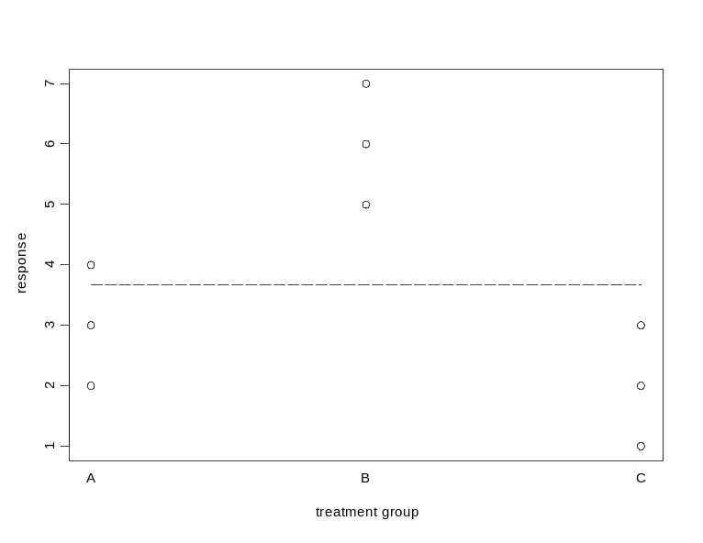
Two Sources of Variability: the total variability
The total sum of squares (SST) is the sum of squared distance between the observations of the overall mean.
The overall mean=3.66667

Slide 26
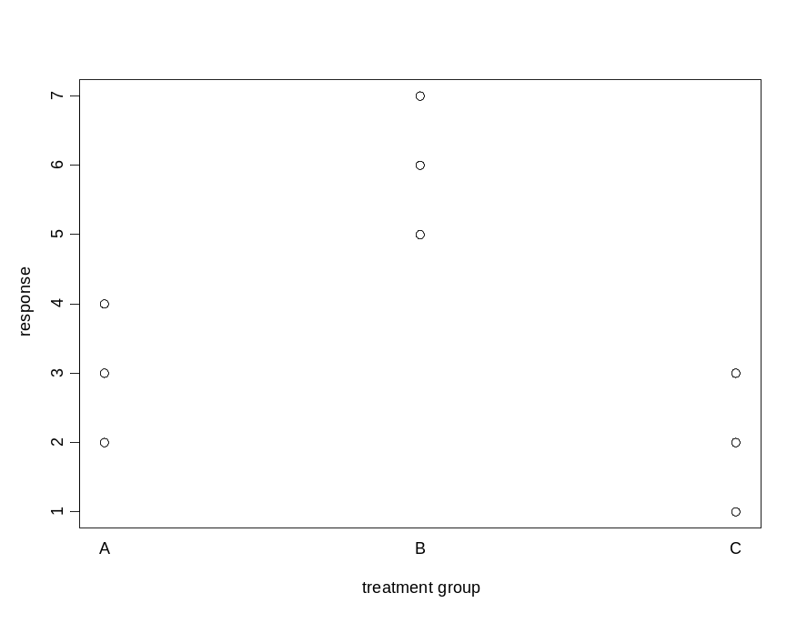
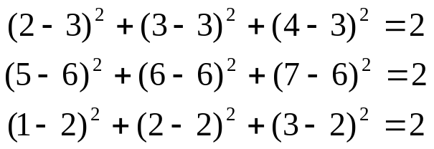
Two Sources of Variability: the variability within the groups
The sum of squares within the groups in the sum of squared diffrence between the observations at each group to the group mean.
A
B
+
+
C
6
Groups means: 3 (group A), 6 (group B) and 2 (group C)

Slide 27
Two Sources of Variability
Total variability
SST=32
SSW=6
SSB=26
Variability within the groups
Variability between the groups
SST=SSW+SSB
Another notaion: SST=SSE+SSTR

Slide 28
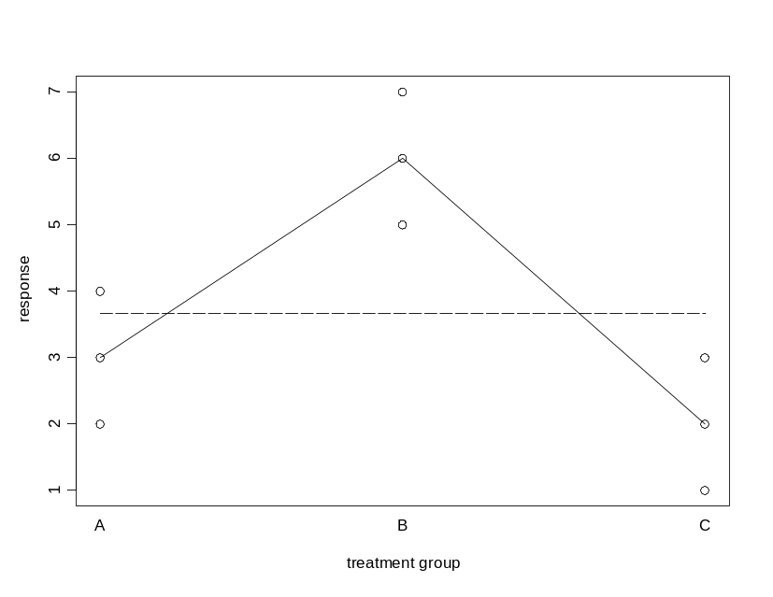
Two Sources of Variability: the variability between the groups
The sum of squares between the groups in the sum of squared diffrence between the group means to the overall mean.
groups means
overall mean
overall mean
groups means
The sample size at each group

Slide 29
Two sources of variability
Recall that the aim of the analysis is to test if the mean response across the factor levels are equal.
In the next few slides we focus on two datasets.
  In the first there is no different in the mean response across the factor levels.
  The second is an example of a dataset in which the means are not equal.
Mind that: when we say “the means” we means the parematers (or the population mean) and NOT the sample means !!!!!

Slide 30
Hypothetical experiments
We consider a one factor experiment in which the factor has thee levels: A, B and C.
There are 3 observations at each factor level.
Sample size: N=9.
Sample size per group: n_{i}=3, i=1,2,3.
Number of groups: I=3.

Slide 31
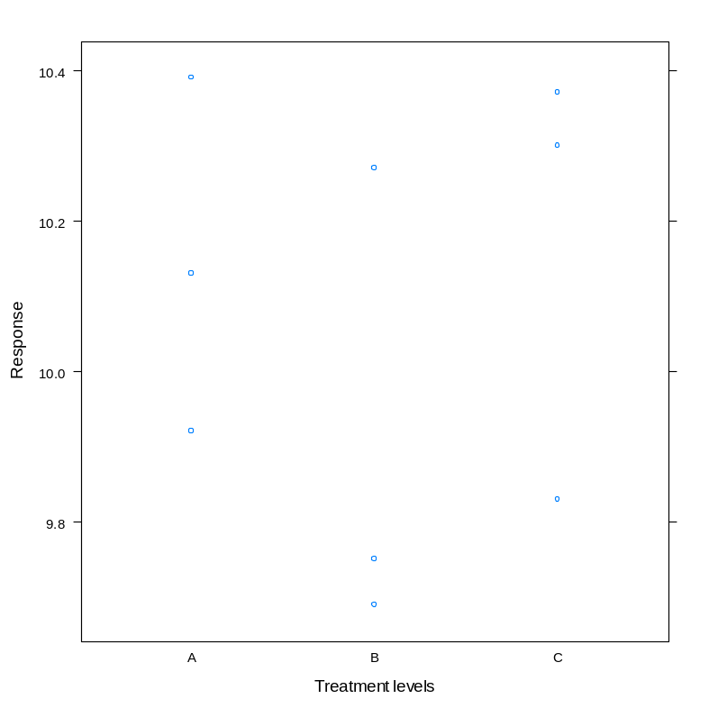
Example 1: data1
Groups’ means and dot plot
> tapply(data1$response, list(data1$Treat), mean)
A B C
10.146667 9.903333 10.166667
> tapply(data1$response, list(data1$Treat), sd)
A B C
0.2354428 0.3189566 0.2936551
EXAMPLE 1

Slide 32
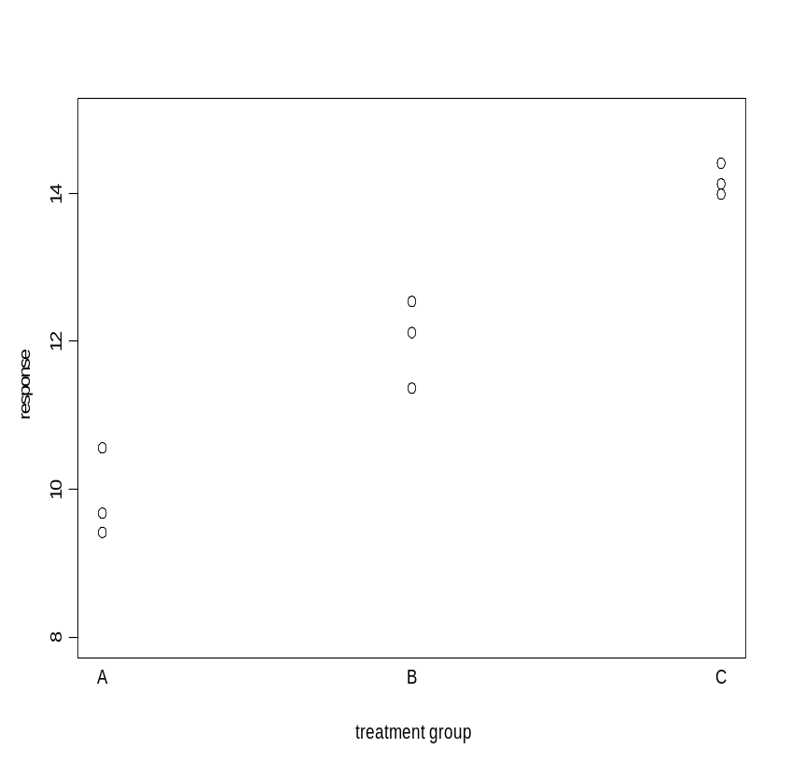
Example 2: data2
Groups’ means and dot plot
> tapply(data2$response, list(data2$Treat), mean)
A B C
9.886667 12.010000 14.073333
> tapply(data2$response,list(data2$Treat), sd)
A B C
0.59743898 0.59270566 0.07371115
EXAMPLE 2

Slide 33
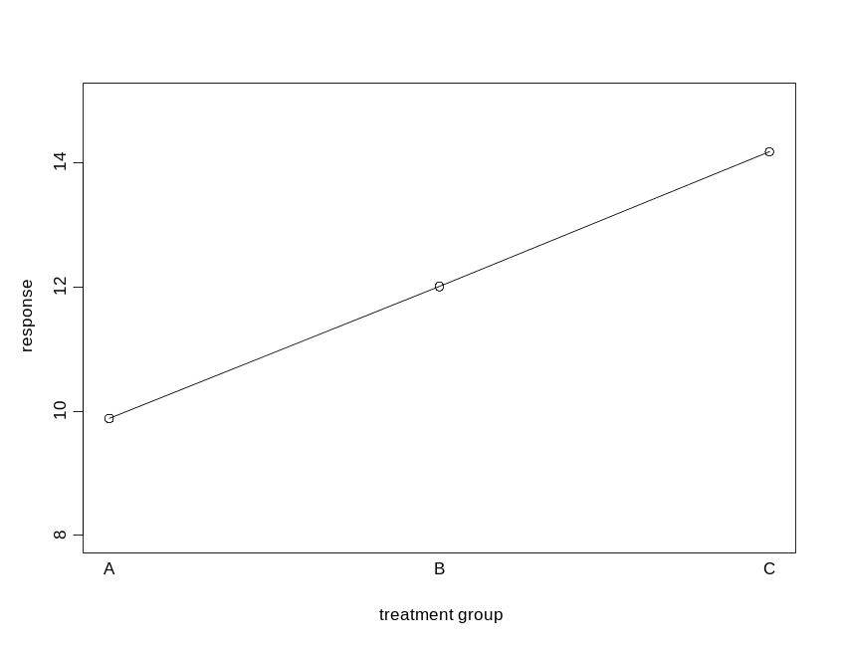
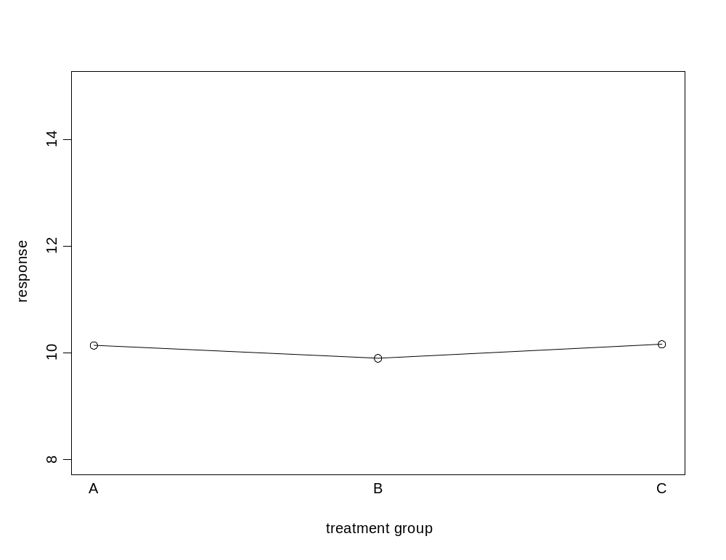
Means plot
EXAMPLE 2
EXAMPLE 1

Slide 34
Example 2: the variability within the group
The variability with a group is the sum of sqaures between the response the group’s mean.
Within each group, the variability seems to be more or less the same.
We can see that the value of the response depends on the factor level.
EXAMPLE 2

Slide 35
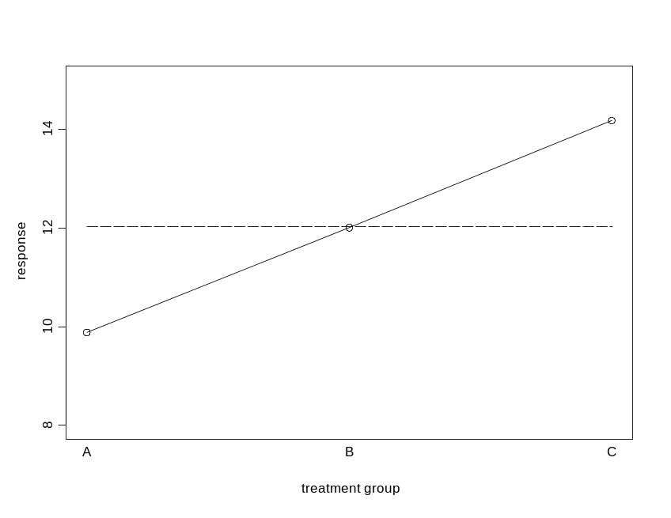
Example 2: the variability between the groups
EXAMPLE 2
The difference between the group’s mean to the overall mean.

Slide 36
One-way ANOVA using R: the aov() function

Slide 37
The function aov( ) in R
Fitting one-way ANOVA model with function aov ( )
> fit.data2 <- aov(response ~ Treat, data = data2)
Output
> aov(fit.data2)
Call:
aov(formula = fit.data2)
Terms:
Treat Residuals
Sum of Squares 26.294067 1.427333
Deg. of Freedom 2 6
Residual standard error: 0.4877385
Estimated effects may be unbalanced
factor
The aov(fit.data2) gives information about the data structure and about the observations used for the analysis.
EXAMPLE 2

Slide 38
Sources of variability
The SAS System
The ANOVA Procedure
Dependent Variable: response
Sum of
Source DF Squares Mean Square F Value Pr > F
Model 2 27.60708889 13.80354444 54.92 0.0001
Error 6 1.50793333 0.25132222
Corrected Tota 8 29.11502222
The second part of the output is the ANOVA table.
The column Sum of Squares presents the between, the within and the total sum of squares.
The variability
Within the groups
The variability between the groups
EXAMPLE 2

Slide 39
Sources of variability
The column Sum of Squares presents the between and the within (residual) sum of squares.
> summary(fit.data2)
Df Sum Sq Mean Sq F value Pr(>F)
Treat 2 26.294 13.147 55.27 0.000136 ***
Residuals 6 1.427 0.238
---
Signif. codes: 0 ‘***’ 0.001 ‘**’ 0.01 ‘*’ 0.05 ‘.’ 0.1 ‘ ’ 1
The variability
Within the groups
The variability between the groups
EXAMPLE 2

Slide 40
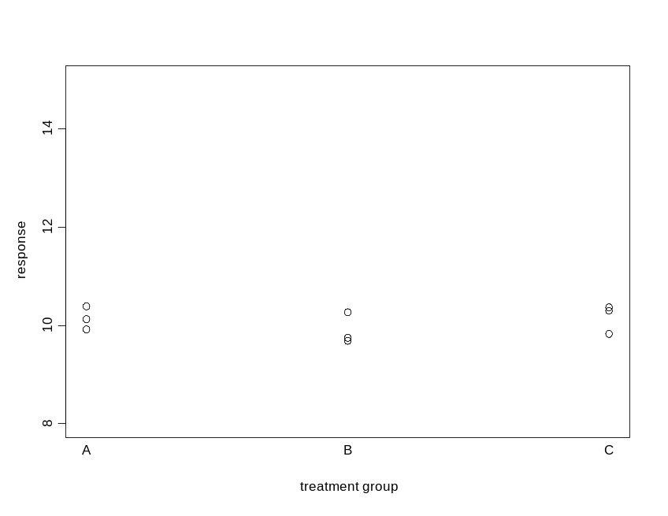
The variability within the groups (SSW)
> summary(fit.data1)
Df Sum Sq Mean Sq F value Pr(>F)
Treat 2 0.1290 0.06448 0.795 0.494
Residuals 6 0.4868 0.08113
EXAMPLE 1
SSW: The error sum of squares is the within group sum of sqaures. This is the within group source of variability.

Slide 41
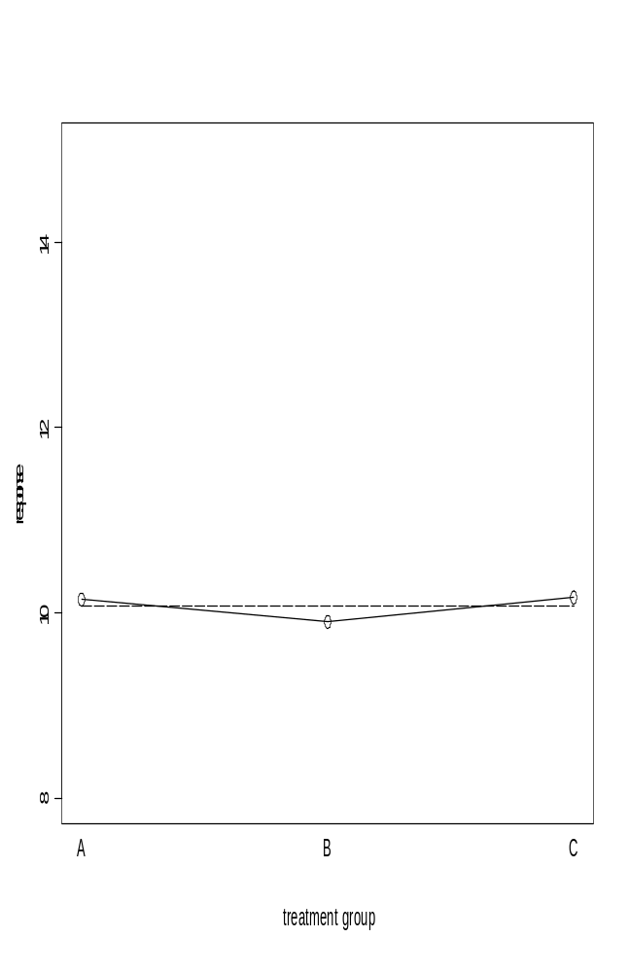
The variability between the groups (SSB)
EXAMPLE 1
> summary(fit.data1)
Df Sum Sq Mean Sq F value Pr(>F)
Treat 2 0.1290 0.06448 0.795 0.494
Residuals 6 0.4868 0.08113
SSB: The model sum of squares is the between group sum of sqaures. This is the group source of variability.

Slide 42
Dgrees of freedom, mean squares and the F-value
> summary(fit.data1)
Df Sum Sq Mean Sq F value Pr(>F)
Treat 2 0.1290 0.06448 0.795 0.494
Residuals 6 0.4868 0.08113
I-1
0.06448
0.08113
n-I
F=
= 0.79
n=9,I=3:
n-1=8
n-I=6
I-1=2
Where:
I - is the factor level
n - is the sample size
0.12895556 / 2 = 0.06447778
0.48680000 / 6 = 0.08113333
EXAMPLE 1

Slide 43
...and now to the big question...
HOW CAN WE TEST IF THE MEAN RESPONSE IS EQUAL ACROSS THE GROUPS?
EXAMPLE 1
EXAMPLE 2
What is the main diference between the two examples?

Slide 44
Model formulation and hypotheses testing

Slide 45
One-Way ANOVA model
The one way ANOVA model is a statistical model which we use in order to test the null hypothesis that the mean response across the factor level equal.
It does not tell us which one is different.

Slide 46
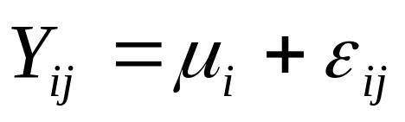
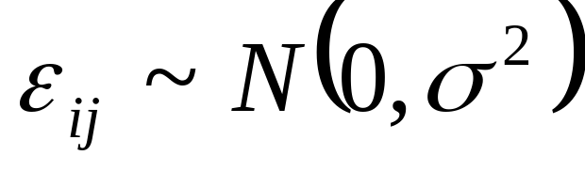
One-Way ANOVA model: model formulation
Random error, assumed to follow normal distribution with constant varaince.
Parameters: fixed but unknown and needed to be estimated
Model assumptions are:
The random error is nornal distributed.
The varaince is constant across the factor levels.

Slide 47
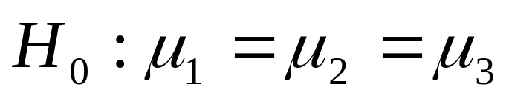


The Null Hypothesis: no treatment effect
For a model in which the factor has three levels we wish to test the null hypothesis:
This means that we want to test if the means across all factor levels are equal.
Mind that: we test if the parameters ( ) are equal, not if the sample means ( ) are equal.

Slide 48
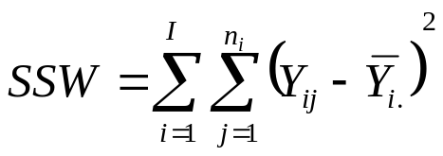
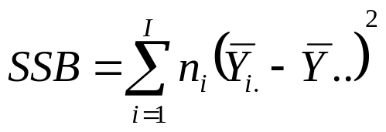
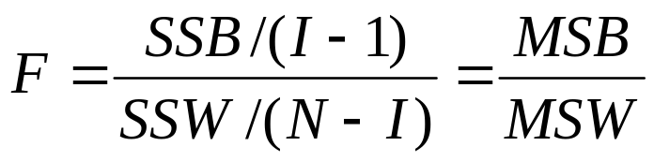
Test Statistic
Within group sum of squares
Between group sum of squares
The test statistic, F, is the ratio between the mean of the between sum of squares (SSB) and the mean of the within sum of squares.

Slide 49
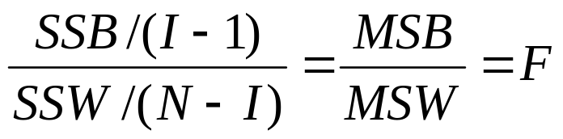
Test Statistic in R
Within group sum of squares/dgree of fredom
=
Between group sum of squares/dgree of fredom
> summary(fit.data1)
Df Sum Sq Mean Sq F value Pr(>F)
Treat 2 0.1290 0.06448 0.795 0.494
Residuals 6 0.4868 0.08113

Slide 50
Intuition behind the F-test
If there is no difference between the mean response across the factor levels, than we expect that SSB will be relativly small (since the group means are closed to the overall mean.
This means that we will reject the null hypothesis for a “large” value of SSB or a “large” value of F.
What is a large value ?
In example 1 F=0.79, is it large ?
EXAMPLE 1

Slide 51
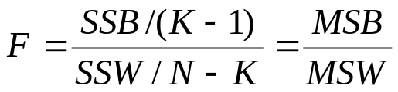
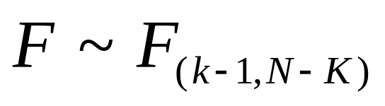
Distribution of the test Statistic under the null hypothesis
Under the null hypothesis, the distribution of the test statistic:
is known.
The test statistic
The distribution under the null hypothesis is F(k-1,N-k)

Slide 52
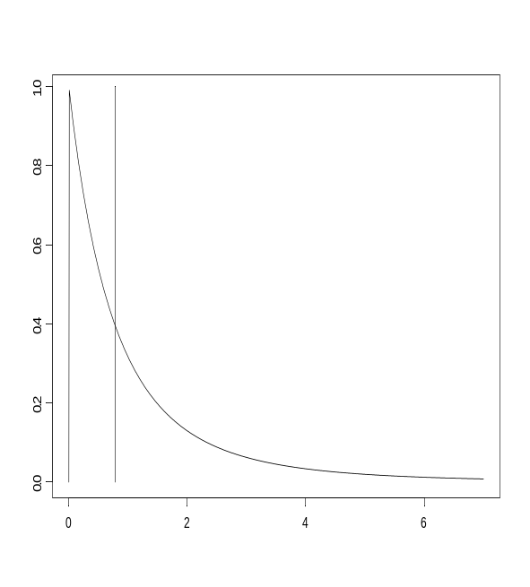
Inference
The decision rule:
If the P-value > 0.05 we do not reject the null hypothesis.
If the P-value < 0.05 we reject the null hypothesis.
Conclusion: we do not reject the null hypothesis since P-value=0.49 > 0.05.
F(2,6)
Df Sum Sq Mean Sq F value Pr(>F)
Treat 2 0.1290 0.06448 0.795 0.494
Residuals 6 0.4868 0.08113
K-1=2, N-K=6

Slide 53
Inference
The plot shows the distribution of the test statistic (the desity function) under the null. The reed line is the observed value of the test statistic, i.e. 0.79.
The P-value is the probability to obsrved an exterem value, i.e. Values that greater or equal to 0.79.
The P-value is the area under the curve in the right side of the red line.
F(2,6)
Df Sum Sq Mean Sq F value Pr(>F)
Treat 2 0.1290 0.06448 0.795 0.494
Residuals 6 0.4868 0.08113
I-1 = 2, n – I = 6

Slide 54
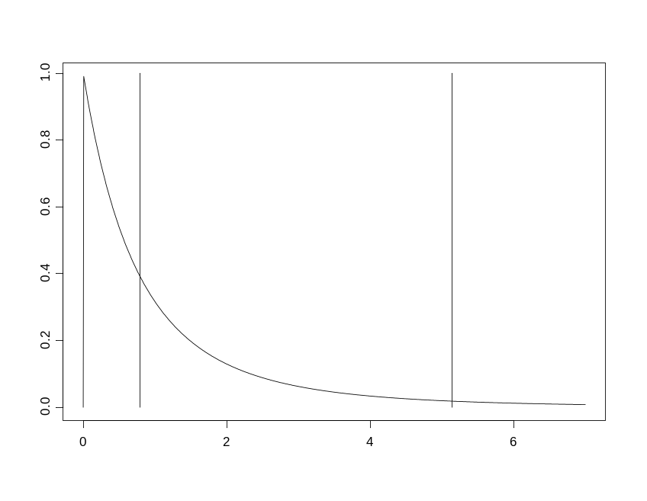
Inference
Critical value:
The P-value is the pobability to observed the value of the test statistics (0.79) under the null hypotheses.
If P-value > 0.05 we do not reject the null hypothesis.
Df Sum Sq Mean Sq F value Pr(>F)
Treat 2 0.1290 0.06448 0.795 0.494
Residuals 6 0.4868 0.08113

Slide 55
Using the ANOVA table to test the null hypothesis
EXAMPLE 1
EXAMPLE 2
Df Sum Sq Mean Sq F value Pr(>F)
Treat 2 0.1290 0.06448 0.795 0.494
Residuals 6 0.4868 0.08113
Df Sum Sq Mean Sq F value Pr(>F)
Treat 2 26.294 13.147 55.27 0.000136 ***
Residuals 6 1.427 0.238
Example 1: P=0.49 > 0.05, we do not reject H0
Example 2: P=0.0001 < 0.05, we reject H0

Slide 56
Fitting ANOVA model: the steps of the analysis
Descriptive statistics
Mean and S.D. By group
Graphical display
Stripplot, boxplot, mean plot etc.
Use ggplot2
Model formulation
Estimation and Inference
aov()

Slide 57
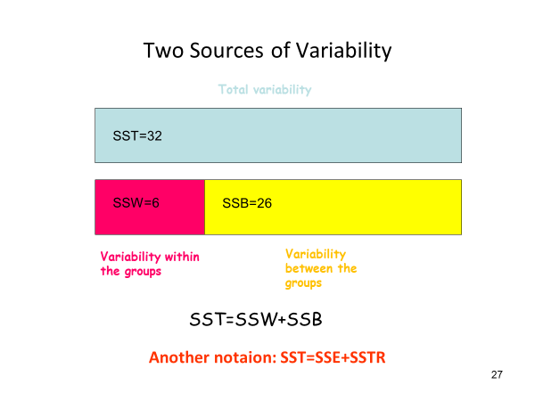
Summary
Model
Output
> fit.data <- aov(response ~ Treat, data)
response
Factor mean
ANOVA table.
Inference for the null hypothesis:

Slide 58
Analysis of the pharmacutical experimant

Slide 59
Descriptive analysis
The sample mean in the active drug group is equal to 5.16 higher than the sample mean in the control group (3.23).
The variability seems to be equal in the two groups (S.D=0.52 in the active drug agroup compared with S.D=0.57 in teh control group).
N
treat Obs N Mean Std Dev Minimum Maximum
-------------------------------------------------------------------------------------------------------
QNP 12 12 5.1647159 0.5179239 4.3377351 5.8956120
SALINE 12 12 3.3231425 0.5719953 2.4675655 4.1198905
----------------------------------------------------------------------------------------------------------

Slide 60
Graphical displays
Both the stripplot and the boxplot indicate that the response is higher in the active drug group.
The stripplot shows clearly that the within variability in the two groups is almost the same.

Slide 61
Model formulation
We consider the following one-way ANOVA model
Here, μ_{i} is the mean response in treatment group i, i =1,2 and Y_{ij} is the
distance travled (on log scale) by the j’th rat in i’th treatment group .
Sample sizes were equal in both treatment group, n₁=n₂=12 and N=24.
It is further assumed that .

Slide 62
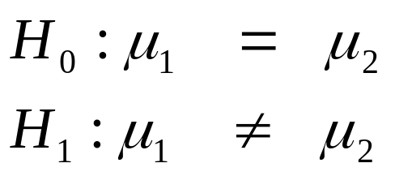

Inference
> summary(fit.biophar)
Df Sum Sq Mean Sq F value Pr(>F)
Treat 1 20.35 20.348 68.35 3.41e-08 ***
Residuals 22 6.55 0.298
---
Signif. codes: 0 ‘***’ 0.001 ‘**’ 0.01 ‘*’ 0.05 ‘.’ 0.1 ‘ ’ 1
We wish to tst the hypothesis
that the durg has no effect on the
response. Formaly we test the
following hypotheses:
We use the F statistic in ordr to
test the hypotheses
Under the null hypotheses:
The model was estimated using the function aov ( ) in R.
F = 68.35 with P < 0.001.
Conclusion: The null hypothesis is rejected (p < 0.05) and we conclude that distanc traveled by rats which recived the active drug is higher than the distance traveled by the rats from the control group.

Slide 63
Model diagnostic

Slide 64
The one-way ANOVA model
The one-way ANOVA models has two components: the unknown parameters and the stochastic part.
Parameter- unknown and fixed
Random error
Our aim is to estimate and to make inference about the parameters. However, the validity of the inference depend is the model assumptions hold

Slide 65


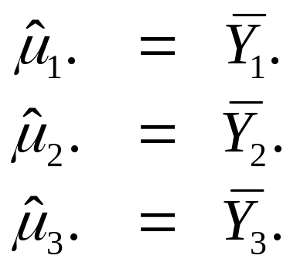
Parameters and paramter estimates
Parameters:
Parameter estimates:
The parameters in the model represent the populations mean. The parameters estimates are for the populations mean are the same means at each group.

Slide 66
Model assumptions (1)
Normal distribution of the random error
Constant variance
The random component of the model is assumed to follow normal distribution with mean zero and constant variance.
This assumption should be validated.

Slide 67
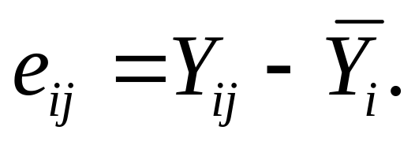
The residuals
The random error is not observed and, similar to the linear regression model, we estimate it with the residual e_{i}
The observation
Parameter estimate for the group mean

Slide 68
Model assumptions (2)
Normality
Constant variance
qq normal plot for the residuals. If the normality assumption holds, the points qqnormal plot should be a straight line.
We use two plots to check this assumption: (1) scaterplot for the response and (2) boxplot for the residuals.

Slide 69
Model diagnostic in R
Illustration with three examples

Slide 70
Example 1: The Data
> tapply(Data1$Response,list(Data1$Treat),mean)
1 2 3
9.786667 10.538333 9.906667
> tapply(Data1$Response,list(Data1$Treat),sd)
1 2 3
0.4274420 0.4956780 0.3274548
The Data
1 1 10.30
2 1 9.12
3 1 9.97
4 1 9.56
5 1 9.66
6 1 10.11
7 2 10.56
8 2 10.60
9 2 9.66
10 2 10.55
11 2 10.20
12 2 10.66
13 3 9.67
14 3 9.44
15 3 10.39
16 3 9.95
17 3 9.92
18 3 10.07
3 groups (I=3).
6 observations per group (n_{i}=6).

Slide 71
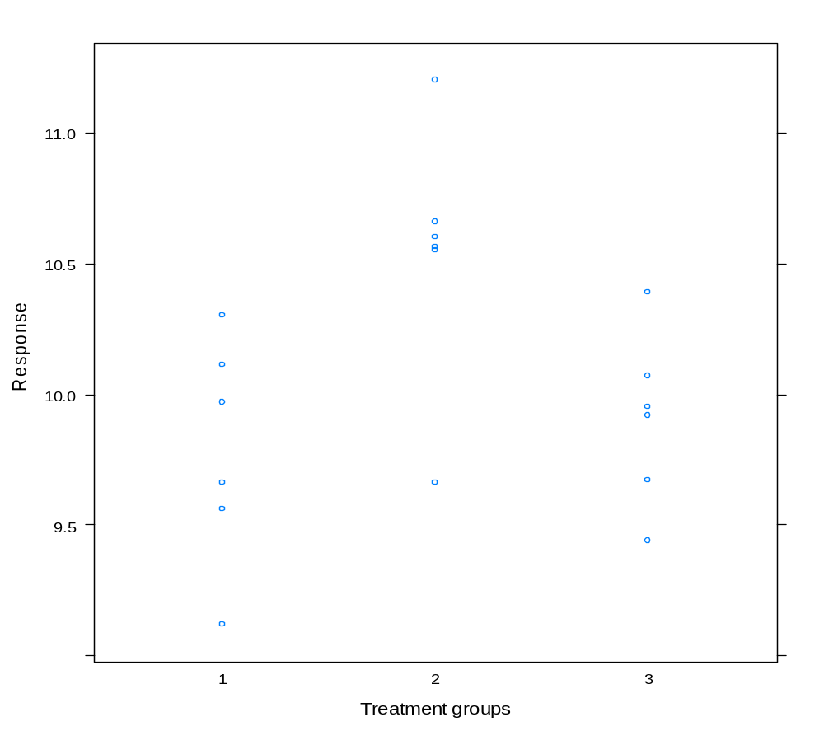
Graphical display: dotplot by treatment group

Slide 72
Output
Treat Response predict resid
1 1 10.30 10.01722 0.28277778
2 1 9.12 10.01722 -0.89722222
3 1 9.97 10.01722 -0.04722222
4 1 9.56 10.01722 -0.45722222
5 1 9.66 10.01722 -0.35722222
6 1 10.11 10.01722 0.09277778
7 2 10.56 10.07722 0.48277778
8 2 10.60 10.07722 0.52277778
9 2 9.66 10.07722 -0.41722222
10 2 10.55 10.07722 0.47277778
11 2 11.20 10.07722 1.12277778
12 2 10.66 10.07722 0.58277778
13 3 9.67 10.13722 -0.46722222
14 3 9.44 10.13722 -0.69722222
15 3 10.39 10.13722 0.25277778
16 3 9.95 10.13722 -0.18722222
17 3 9.92 10.13722 -0.21722222
18 3 10.07 10.13722 -0.06722222
> Data1$predict <- fit.Data1$fit
> Data1$resid <- fit.Data1$resid
> print(Data1)
Note that the predicted values are simply the group means.

Slide 73
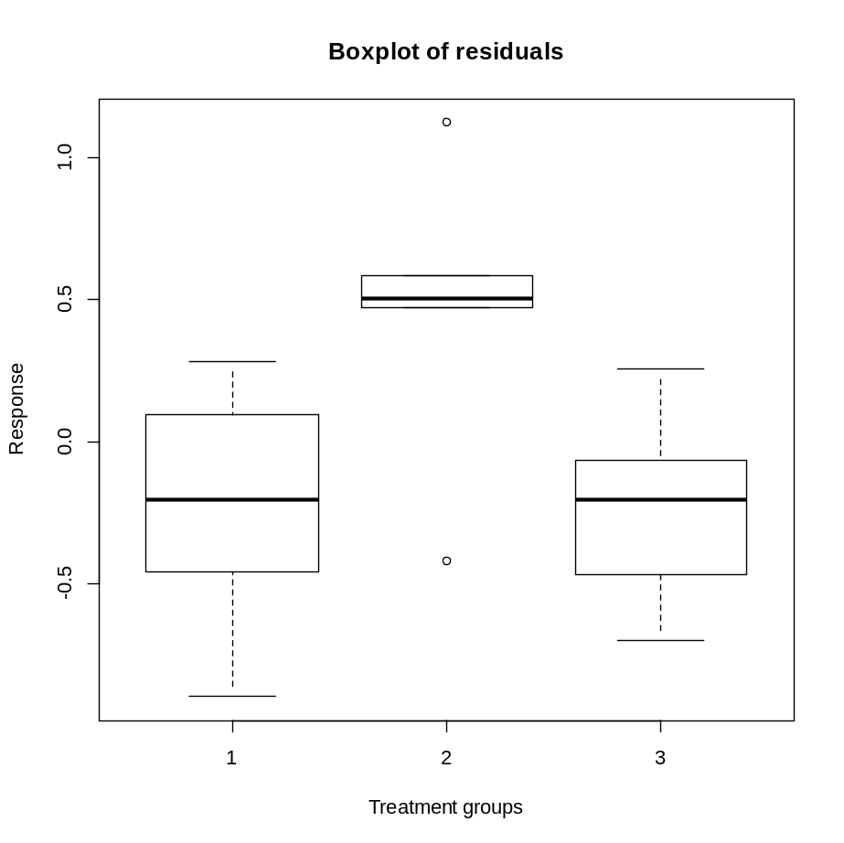
Graphical display: boxplot for the residuals
> boxplot(split(fit.Data1$resid,Treat),
+ xlab = "Treatment groups",
+ ylab = "Response",
+ main = "Boxplot of residuals")
If the variance is constant we expect to see the same boxplots for all treatment groups.

Slide 74
Levene’s test
The Levene’s test is a formal test for constant variance.
> library(car)
> leveneTest(Response~factor(Treat), data = Data1)
Levene's Test for Homogeneity of Variance (center = median)
Df F value Pr(>F)
group 2 0.2251 0.8011
15
We do not reject the null hypothesis.

Slide 75
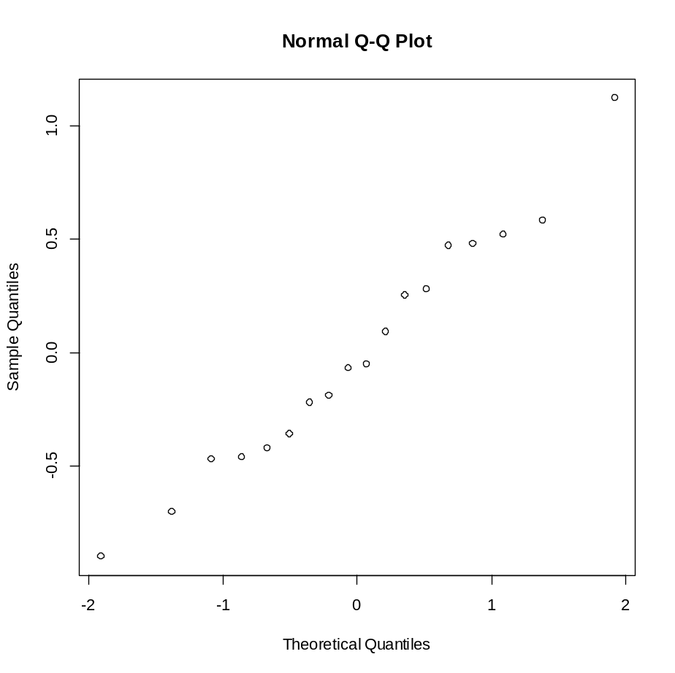
Normal probability plot for the residuals
If the normality assumption holds, the points qqnormal plot should be a straight line.

Slide 76
Example 2: the data
> tapply(Data2$Response, list(Data2$Treat),mean)
Treatment means
1 2 3
10.026667 10.305000 7.766667
> tapply(Data2$Response, list(Data2$Treat),sd)
Treatment SDs
1 2 3
0.2677063 0.9178181 2.6375266
The Data
Treat Response
1 1 10.18
2 1 10.11
3 1 9.96
4 1 9.89
5 1 10.40
6 1 9.62
7 2 10.44
8 2 8.70
9 2 9.88
10 2 10.90
11 2 11.30
12 2 10.61
13 3 4.02
14 3 9.12
15 3 8.15
16 3 10.86
17 3 5.15
18 3 9.30
3 groups (I=3).
6 observations per group (n_{i}=6).

Slide 77
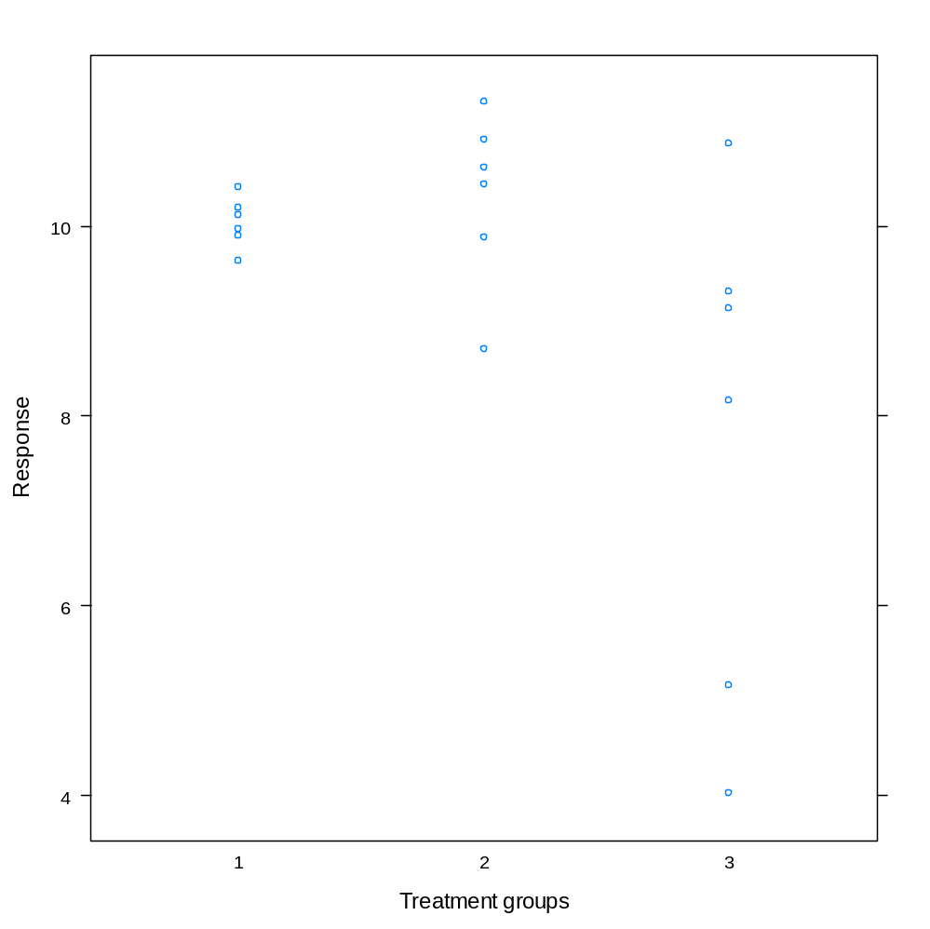
Graphical display: dotplot by treatment group
The variability within each treatment group is not constant.

Slide 78
Inference and levene’s test
Levene’s test
ANOVA table
Df Sum Sq Mean Sq F value Pr(>F)
Treat 1 15.32 15.323 5.185 0.0369 *
Residuals 16 47.29 2.955
---
Signif. codes: 0 ‘***’ 0.001 ‘**’ 0.01 ‘*’ 0.05 ‘.’ 0.1 ‘ ’ 1
Levene's Test for Homogeneity of Variance (center = median)
Df F value Pr(>F)
group 2 4.4458 0.03047 *
15
> fit.Data2 <- aov(Response ~ Treat, data = Data2)
> summary(fit.Data2)
> library(car)
> leveneTest(Response~factor(Treat), data = Data2)
One way ANOVA model for testing factor effects.
Leveve’s test for variance equality across the factor levels.

Slide 79
Predicted values and residuals
> Data2$predict <- fit.Data2$fit
> Data2$resid <- fit.Data2$resid
> print(Data2)
Treat Response predict resid
1 1 10.18 10.496111 -0.31611111
2 1 10.11 10.496111 -0.38611111
3 1 9.96 10.496111 -0.53611111
4 1 9.89 10.496111 -0.60611111
5 1 10.40 10.496111 -0.09611111
6 1 9.62 10.496111 -0.87611111
7 2 10.44 9.366111 1.07388889
8 2 8.70 9.366111 -0.66611111
9 2 9.88 9.366111 0.51388889
10 2 10.90 9.366111 1.53388889
11 2 11.30 9.366111 1.93388889
12 2 10.61 9.366111 1.24388889
13 3 4.02 8.236111 -4.21611111
14 3 9.12 8.236111 0.88388889
15 3 8.15 8.236111 -0.08611111
16 3 10.86 8.236111 2.62388889
17 3 5.15 8.236111 -3.08611111
18 3 9.30 8.236111 1.06388889

Slide 80
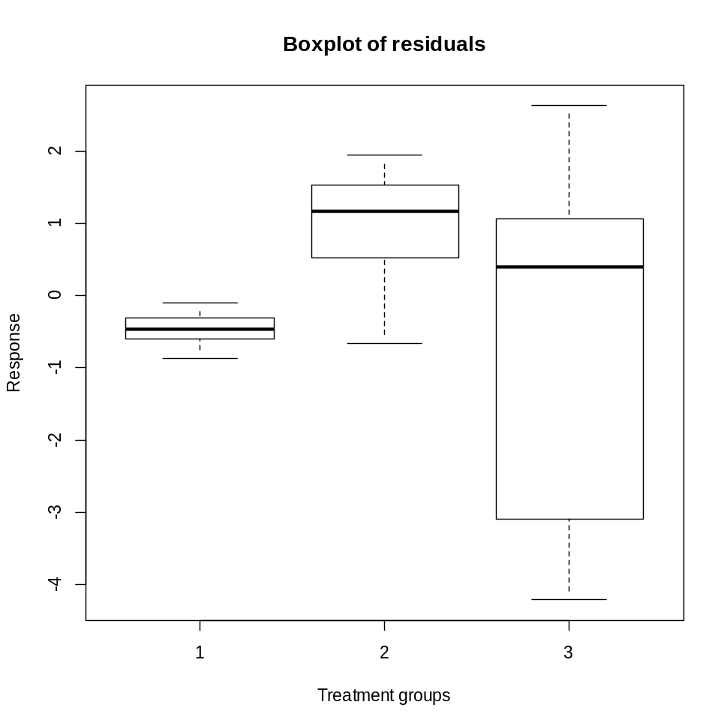
Graphical dispaly: Boxplot for the residuals
> boxplot(split(fit.Data2$resid,Treat),
+ xlab = "Treatment groups",
+ ylab = "Response",
+ main = "Boxplot of residuals")
The boxplot indicates that the variability is not constant.

Slide 81
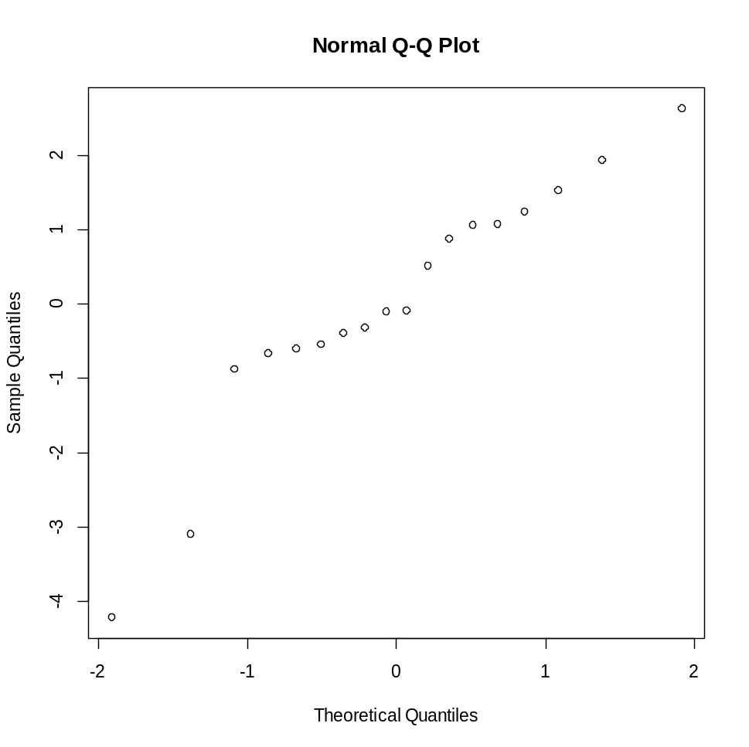
Normal probability plot for the residuals
Taking into account that n=20, the qqnormal plot does not indicates on a problem with the normality assumption.

Slide 82
Model diagnostic in R: normal probability plot

Slide 83
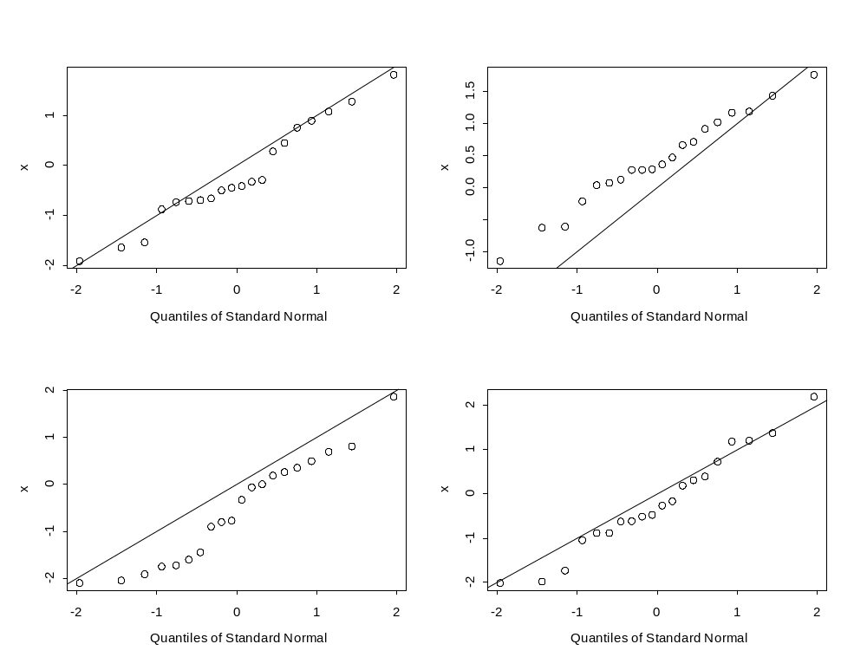
4 samples of size 20
Example of 4 qqnormal plot for 4 random samples from normal distrinution with n=20.
U~N(0,1)

Slide 84
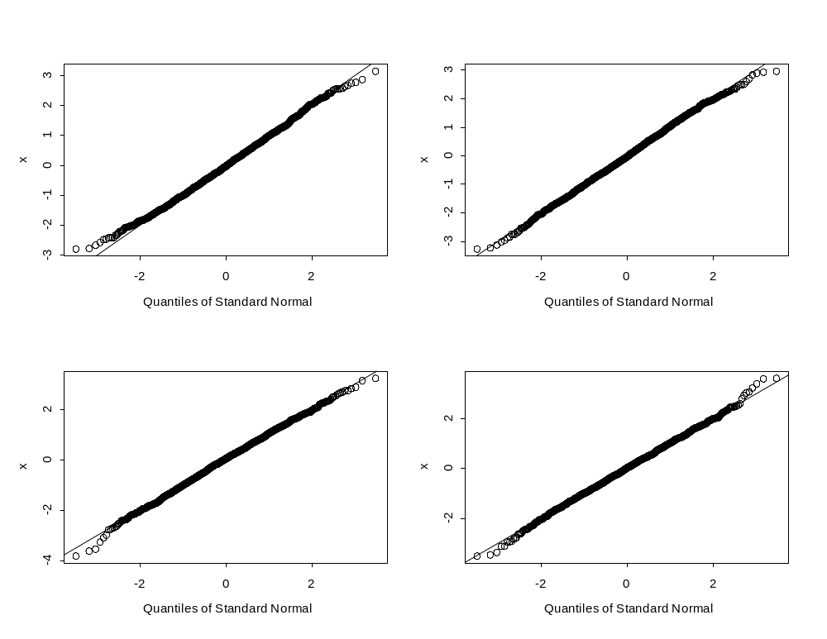
4 samples of size 2000
Example of 4 qqnormal plot for 4 random samples from normal distrinution with n=2000.
U~N(0,1)

Slide 85
3 Examples of normal probability plots for samples of size 10000

Slide 86
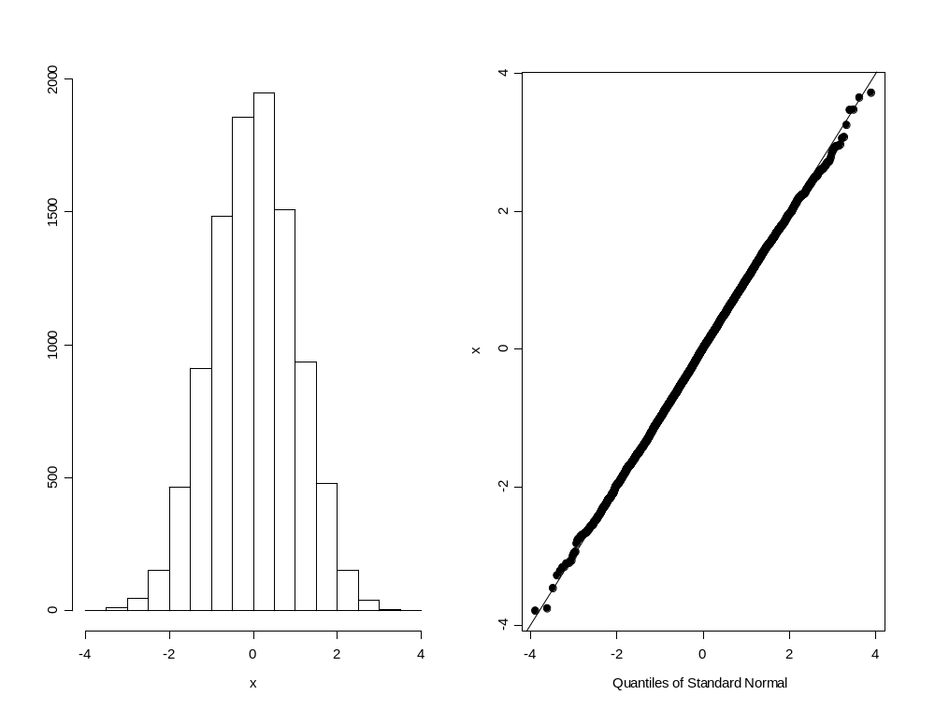
N(0,1)
N=10000

Slide 87
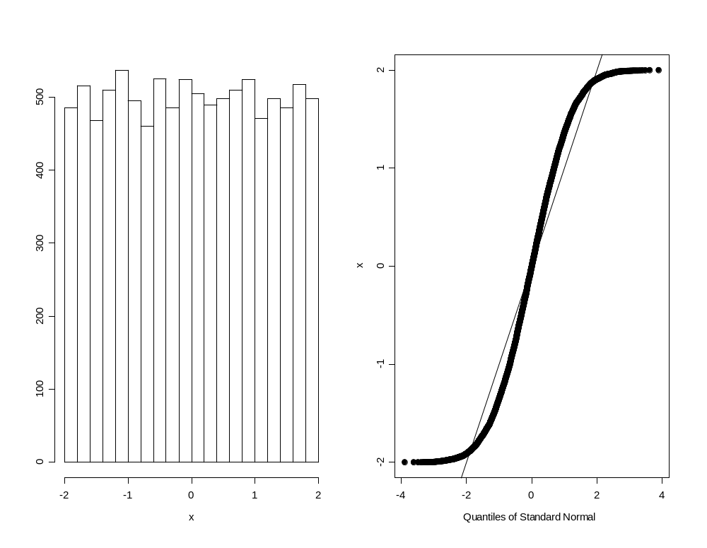
U(-2,2)
N=10000

Slide 88
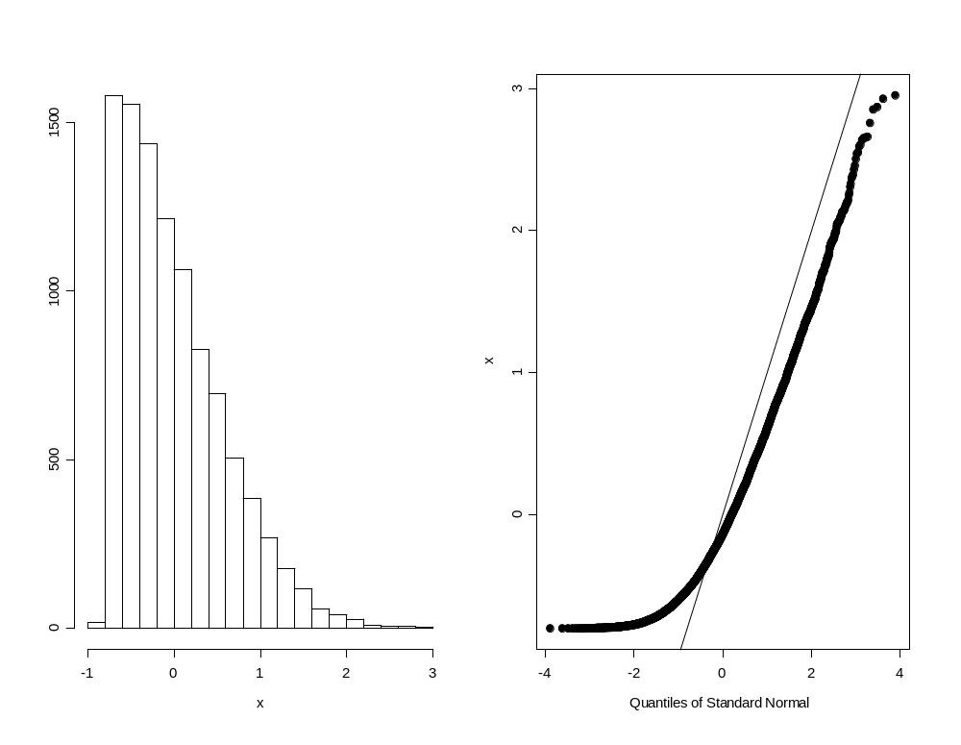
Skewed distribution
N=10000

Slide 89
Summary: R functions
stripplot(), boxplot().
aov().
lm(),glm().
qqnorm().

Slide 90
Summary: model diagnostic
We use three graphical displays for model diagnostic:
  dotplot & boxplot for the response.
  boxplot for the residuals.
  qqnormal plot for the residuals.
In this course, the model diagnostic is only descriptive.
Formal test can be used in order to test if the variance is constant (levene’s test) or the residuals follow a normal distribution (KS test).

Slide 91
One-Way ANOVA Model: Multiple Testing

Slide 92
The problem of Multiplicity (1)
Testing one hypothesis using significant level of 0.05 means that the Type I error is equal to 0.05.
Type I error is the probability to reject the null hypothesis when the null hypothesis is correct.
In other words, we make a decision to reject the null hypothesis and the probability that we are wrong is 0.05.

Slide 93
The problem of Multiplicity (2)
If we need to test K null hypotheses simultaneity and we use for each null hypothesis significant level of 0.05 the over significant level will be much higher.
This means that when we have a problem with multiple testing (when we need to test more than one null hypothesis).
We need to adjust the significant level of each test that we do.

Slide 94
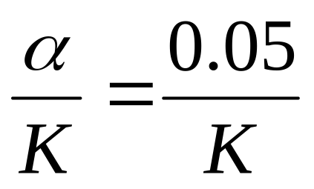
The problem of Multiplicity (3): Bonferroni correction
There are many ways to adjust for multiple testing
In this course we use the Bonferroni correction.
Suppose that we have K tests and we want to keep the overall significant level at 0.05, Bonferroni proposed to test each hypothesis using significant level of:
The overall significant level
For α=0.05
The per-comparison significant level

Slide 95
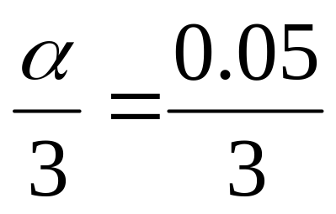
The problem of Multiplicity (4): Bonferroni correction
For example, if we have 3 tests to do and we want to keep the overall significant level at 0.05
This means that for each test we use a significant level of 0.05/3=0.01666667
The overall significant level
For α=0.05
The per-comparison significant level

Slide 96
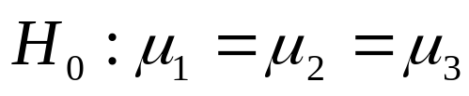
The null hypothesis for the F-test
For one-way ANOVA model with three levels’ factor the null hypothesis is
The null hypothesis states that the three populations’ mean are equal.
If we reject the null hypothesis we conclude that the populations’ means are not equal BUT we do not know which population is different from the other.
For example, it could be that populations’ mean 1 and 2 are not different and they are both different from the third population mean.

Slide 97
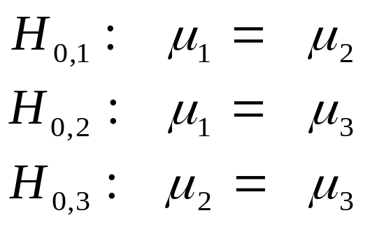
The null hypothesis for the F-test
If we reject the null hypothesis we might want to test each pair of means.
This means that we have three tests to perform and if we want to keep the overall significant level at 0.05 we need to test each hypothesis at a significant level of 0.05/3.

Slide 98
Example 3: the Data
> tapply(Data3$Response, list(Data3$Treat),mean)
1 2 3
10.20000 10.18000 12.47833
The Data
Treat Response
1 1 9.76
2 1 10.60
3 1 10.20
4 1 10.87
5 1 10.17
6 1 9.60
7 2 10.68
8 2 10.87
9 2 9.91
10 2 9.80
11 2 9.45
12 2 10.37
13 3 12.28
14 3 12.38
15 3 12.45
16 3 12.96
17 3 11.61
18 3 13.19
We can see that the sample means in group 1 and 2 are very closed to each other (10.20 and 10.18).
These patterns reveal also in the following two plots.

Slide 99
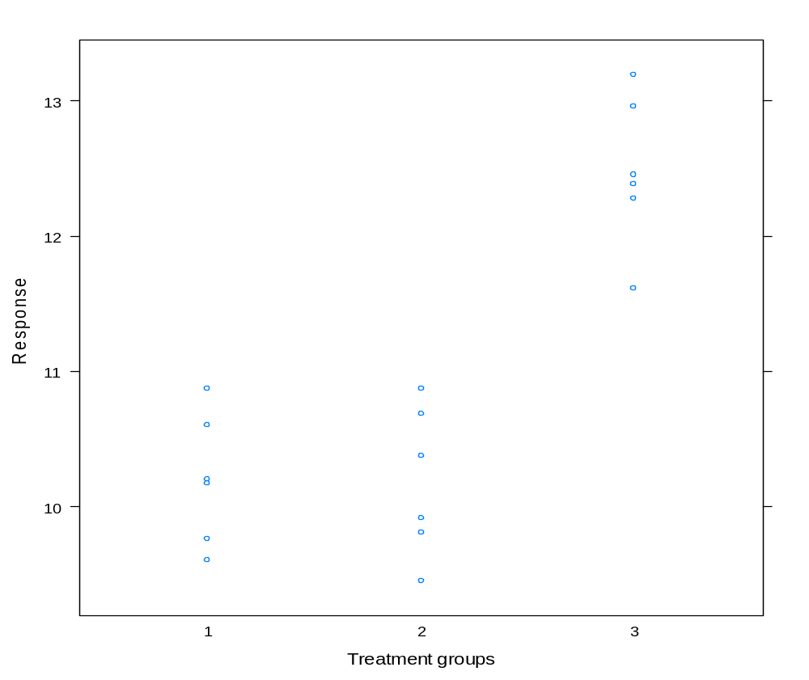
Dotplot by treatment group

Slide 100
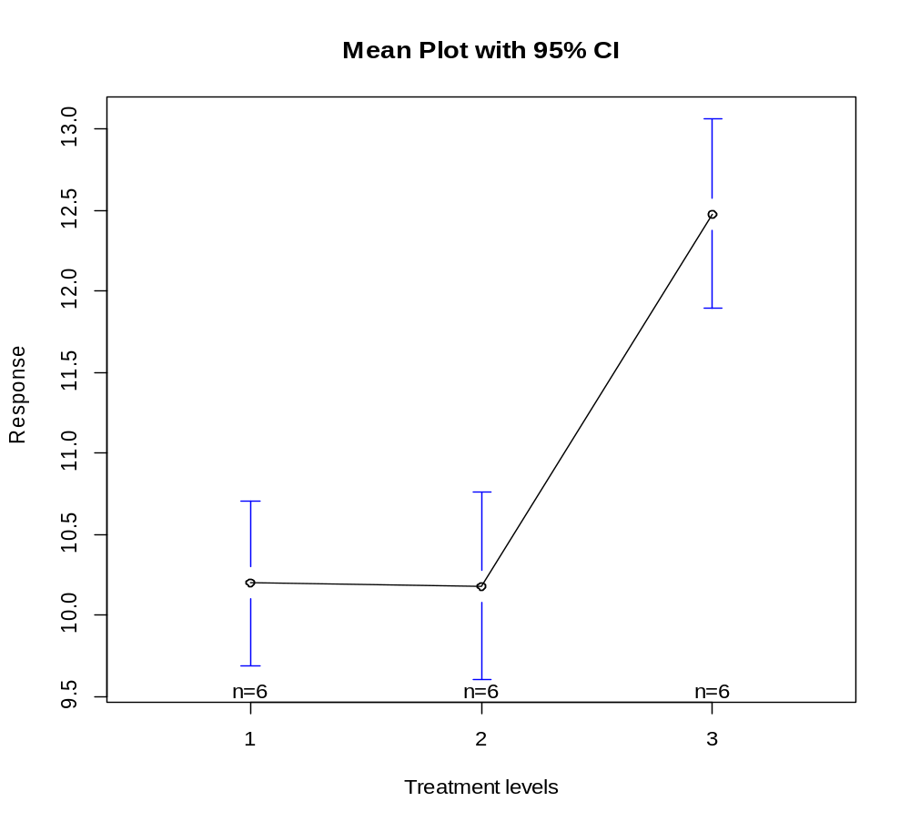
Sample means by treatment group

Slide 101
Inference
> fit.Data3 <- aov(Response ~ Treat, data = Data3)
> summary(fit.Data3)
The null hypothesis is rejected. We can conclude that populations’ means are not equal.
The patterns reveal in the plots indicates that it could be that not all populations’ means are different.
In the next step we would like to test each pair separately.
Df Sum Sq Mean Sq F value Pr(>F)
Treat 1 15.572 15.57 25.97 0.000108 ***
Residuals 16 9.593 0.60
---
Signif. codes: 0 ‘***’ 0.001 ‘**’ 0.01 ‘*’ 0.05 ‘.’ 0.1 ‘ ’ 1

Slide 102
The null hypothesis was rejected, what does it mean ?
It mean that there are differences among the populations’ mean.
It does not mean that all the populations’ means are different from each other.

Slide 103
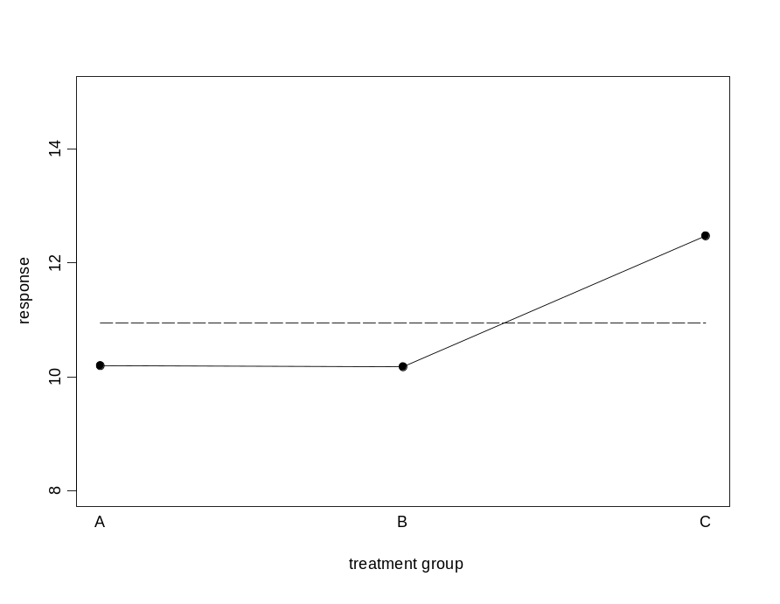
Muptiple comparisons
The next step is to test each pair.
We have 3 tests to perform.
Each test will be performed in significant level of 0.05/3.

Slide 104
Using function pairwise.t.test ( ) for multiple comparisoons
Pairwise comparisons using t tests with pooled SD
data: Response and Treat
1 2
2 1 -
3 6.2e-06 5.6e-06
P value adjustment method: bonferroni
> pairwise.t.test(Response, Treat,
+ p.adj = "bonferroni", data = Data3)
The bonferroni adjustment
Treatment 3 is different from treatments 1 and 2
Treatment 1 is not different from treatment 2
The null hypothesis that the means in treatment 1 and 2 are equal is not rejected.

Slide 105
aov( ) output: global null hypothesis
Df Sum Sq Mean Sq F value Pr(>F)
Treat 1 15.572 15.57 25.97 0.000108 ***
Residuals 16 9.593 0.60
---
Signif. codes: 0 ‘***’ 0.001 ‘**’ 0.01 ‘*’ 0.05 ‘.’ 0.1 ‘ ’ 1
Global F test: the null hypothesis is rejected.

Slide 106
Multiple comparisons with option p.adj = “none”
> pairwise.t.test(Response, Treat,
+ p.adj = "none", data = Data3)
t-tests for all pairwize comparisons, however it does not make correction for the Type I error rate across the pairwise tests.
P values should be compared with alpha/K.

Slide 107
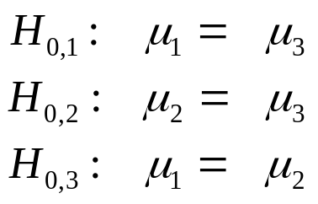
R output
Pairwise comparisons using t tests with pooled SD
data: Response and Treat
1 2
0.95 -
3 2.1e-06 1.9e-06
P value adjustment method: none

Slide 108
More about Multiplicity
A link for an online course about multiple testing (at more advanced level):
https://erbiostat.wixsite.com/inf1/topics

